Slide 1

Influencing and Communication
Chapter 15

Slide 2
Objectives
Fundamentals of Influencing:
Define Influencing
Influencing subsystem

Slide 3
Defining Influencing
Influencing: is the process of guiding the activities of organization members in appropriate directions.
Appropriate directions: those that lead to the attainment of management system objectives.

Slide 4
Defining Influencing
Influencing involves:
focusing on organization members as people
dealing with such issues as:
  morale
  arbitration of conflicts
  the development of good working relationships
It is a critical part of a manager’s job
  the ability to influence others is a primary determinant of how successful a manager will be

Slide 5
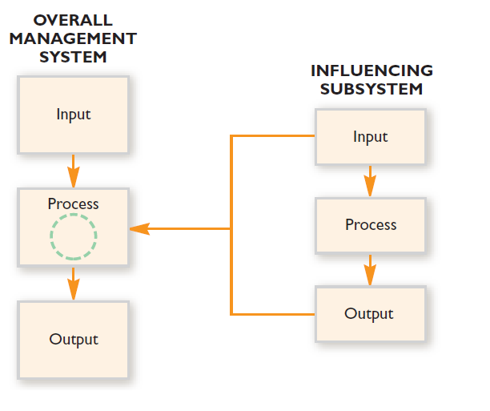
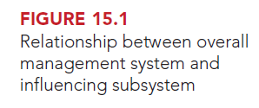
The Influencing Subsystem
The influencing function can be viewed as a subsystem within the overall management system (Like the planning & organizing functions)

Slide 6
The Influencing Subsystem
Primary purpose of influencing subsystem: enhance the attainment of management system objectives by guiding the activities of organization members in appropriate directions.

Slide 7
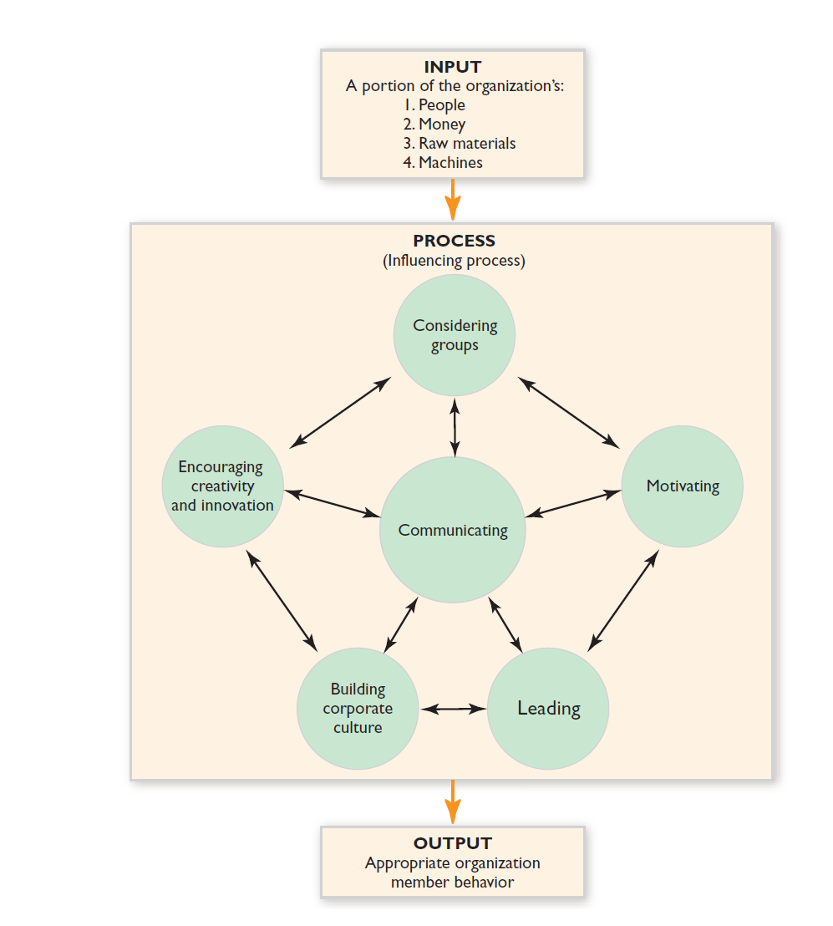
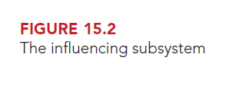
The Influencing Subsystem

Slide 8
The Influencing Subsystem
Constitutes of:
  Input: a portion of the total resources of the overall management system.
  Output: is appropriate organization member behavior.
  Process: the performance of six primary management activities:
    Leading
    Motivating
    Considering groups
    Communicating
    Encouraging creativity and innovations
    Building corporate culture

Slide 9
The Influencing Subsystem
Managers transform input (a portion of organizational resources) into output (appropriate organization member behavior) mainly by performing these activities.
These six activities are interrelated.
Managers accomplish each of these influencing activities by communicating with organization members.

Slide 10
The Influencing Subsystem
Managers first:
  Analyze the characteristics of groups
  Determine how they can be motivated
  Decide on leadership strategy
Leading, motivating, and working with groups will be accomplished through communication.
All management activities are accomplished at least partly through communication.
the ability to communicate is often referred to as the fundamental management skill, why?
  Because communication is used repeatedly by managers

Slide 11
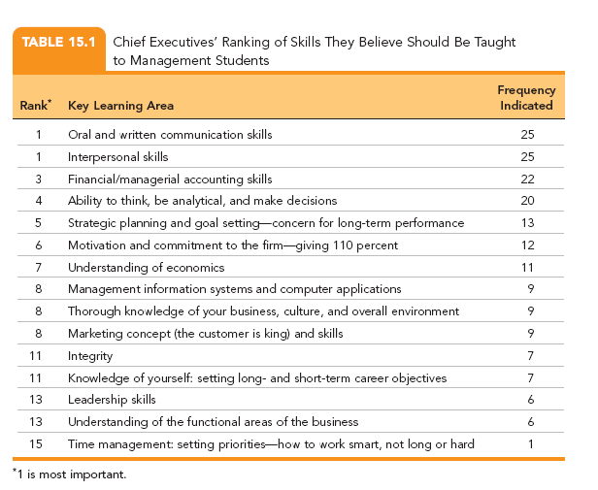
The Influencing Subsystem
Survey results: CEOs ranked written and oral communication skills first (along with interpersonal skills) among those should be taught to management students

Slide 12

Leadership
Chapter 16

Slide 13
Objectives
Defining Leadership:
Leader Versus Manager
The trait approach to leadership

Slide 14
Defining Leadership
Leadership: is the process of directing the behavior of others toward the accomplishment of some objectives
Directing: causing individuals to act in a certain way or to follow a particular course (i.e. to follow organizational policies, procedures, and job descriptions).
Leadership is all about getting things accomplished through people.
Leader
Followers

Slide 15
Defining Leadership
Leadership is one of the four main interdependent activities of the influencing subsystem
Leadership is accomplished to some extent by communicating with others.
Leadership has always been considered a prerequisite for organizational success.
Managers must have a thorough understanding of leadership

Slide 16
Leader vs. Manager
Leading is NOT the same as Managing
(some managers are leaders, some leaders are managers, but they are not identical activities, they are different)
Leadership as one of the four primary activities of the influencing function, and a subset of management.
Managing | Leading
Broader in scope Focuses on behavioral & non-behavioral issues Making sure the job is done | Emphasizes behavioral issues Focuses on the people who do the job

Slide 17
Leader vs. Manager
Merely possessing management skills is NOT Sufficient for success as an executive in the business world.
Executives should combine the two roles and have both management skills (focusing on org processes) + leadership skills = to achieve organizational success
They should focus on both: Organizational Processes (management) and Concern for People (leadership)

Slide 18
Leader vs. Manager
although not all managers are leaders, the most effective managers over the long term are leaders.
Effective Managers

Slide 19
The Trait Approach To Leadership
The Trait Approach to Leadership: is based on early leadership research that assumed a good leader is born, not made.
This research attempted (tried) to describe successful leaders as precisely as possible
Reasoning: If a complete profile of the traits of a successful leader could be drawn -easy→ to identify the individuals who should and should not be placed in leadership positions.

Slide 20
The Trait Approach To Leadership
Successful leaders tend to possess the following characteristics:
Intelligence, including judgment and verbal ability
Past achievement in scholarship and athletics
Emotional maturity and stability
Dependability, persistence, and a drive for continuing achievement
The skill to participate socially and adapt to various groups
A desire for status and socioeconomic position

Slide 21
The Trait Approach To Leadership
Evaluation of those trait studies however, have concluded that their findings are inconsistent.
50 years of study have failed to produce one personality trait or set of qualities that can be used consistently to differentiate leaders from nonleaders. Researchers are still examining this issue.
Research has failed to definitively articulate (bind) a trait or a combination of traits that indicate an individual will be a successful leader

Slide 22
The Trait Approach To Leadership
Contemporary management writers and practitioners:
  leadership ability cannot be explained by and individual’s traits or inherited characteristics.
  They believe that individuals can be trained to be good leaders. Leaders are made, not born.
  That is why thousands of employees each year are sent through leadership training programs.
    To enhance company success
    To attract the best college graduates as new hires

Slide 23
Leadership Styles
Transformational Leadership
Coaching
Super-leadership
Servant Leadership
Entrepreneurial Leadership

Slide 24
Leadership Styles – (1) Transformational Leadership
Transformational Leadership: is the leadership that inspires organizational success by profoundly affecting followers’ beliefs in what an organization should be, as well as their values (such as justice & integrity)
It is also called Charismatic Leadership and Inspirational Leadership
  It creates the sense of duty in the organization
  It encourages new ways of handling problems
  It promotes learning within the org members
It is having more attention nowadays because many organizations are going through the challenge of dramatic changes to be more competitive in a global business.

Slide 25
Leadership Styles – (1) Transformational Leadership
The Tasks of Transformational Leaders:
They raise followers’ awareness of organizational issues and their consequences (understand high priority issues and what will happen if they were not resolved successfully)
They create a vision of what the organization should be, build commitment to that vision throughout the organization, and facilitate organizational changes that support the vision (consistent with the organization strategy)

Slide 26
Leadership Styles – (2) Coaching
Coaching: is leadership that instructs followers on how to meet the special organizational challenges they face.
  The coaching leader identifies inappropriate behavior in followers and suggest how they might correct it.
  Coaching is important nowadays because the increasing use of teams
Coaching Behavior:
Listens closely: to gather facts and feelings & emotions
Gives emotional support: personal encouragement to motivate them to do their best to meet the high demands of successful organizations
Shows by example what constitutes appropriate behavior: by demonstrating (showing) expertise, they gain trust & respect of followers.

Slide 27
Leadership Styles – (2) Coaching

Slide 28
Leadership Styles – (3) Servant Leadership
Servant Leadership: leaders view their primary role as helping followers in their quests to satisfy personal needs, aspirations, and interests.
    They place high value on service to others over self-interests
    They see their main responsibility as the care of human resources of the organizations.
    They think that human resources are the most valuable resource
    They try to transform their followers into wiser and more autonomous individuals → more successful organization
Servant leadership focuses on empowerment, sense of community, & sharing of authority
Servant leadership has high potential for enhancing org. success.

Slide 29
Leadership Styles – (3) Servant Leadership
Characteristics of Servant leaders are:
  Good listeners: (how?)
  Persuasive: (how?)
  Aware of their surroundings: (how?)
  Empathetic: (how?)
  Stewards: (how?)
  Empathy: is the intellectual identification with the feelings, thoughts, or attitudes of others.
  Steward: an individual who is entrusted with managing the affairs of others

Slide 30
Leadership Today

